Slide 1
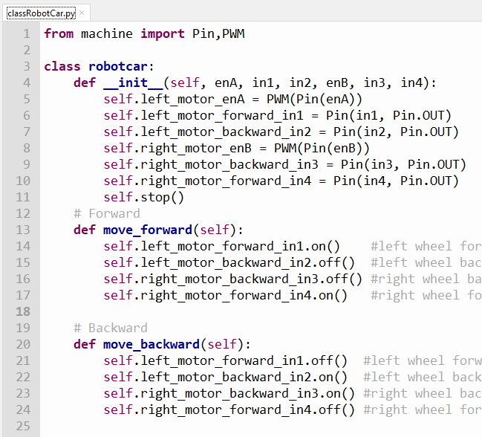
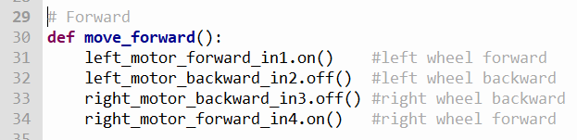
CLASSES IN PYTHON
robot.move_forward()
robotcar
If I share my class with you

Slide 2
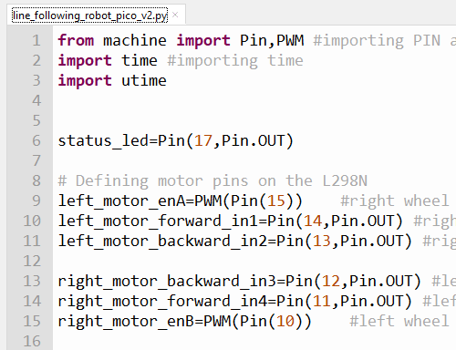
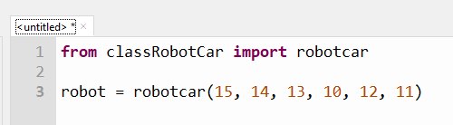
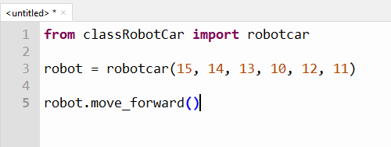

Slide 3
The robotcar class
It’s just a recycleable python program – classRobotCar.py
Contained with it is the robot class
Review of classRobotCar.py
classRobotCar.py
class robotcar……
def move_forward()
def move_backward()
def turn_left()
def turn_right()
def stop()
from classRobotCar import robotcar

Slide 4
The robot class has 5 modules or methods
move_forward()
move_backward()
turn_left()
turn_right()
stop()

